Slide 1



.
SRI RAMAKRISHNA ENGINEERING COLLEGE
[Educational Service:SNR Sons Charitable Trust]
[Autonomous Institutions,Accredited by NAAC with ‘A’ Grade]
[Approved by AICTE and Permanently Affiliated to Anna University,Chennai.]
[ISO 9001:2015 Certified and All Eligible Programme accredited by NBA]
Vattamalaipalayam, N.G.G.O Colony, Coimbatore, Tamil Nadu 641022
SMART EMAIL ASSISTANT
GUIDED BY: SUBMITTED BY:
Mr.R.Kanagaraj, Assitant Professor,CSE Kavya.A(1601107)
Notes:
GOOD MORNING ALL. THIS IS KAVYA FROM FINA YEAR CSE. MY PROJECT IS GUIDED BY MR. KANAGARAJ.
MY PROJECT IS SMART EMAIL ASSISTANT.

Slide 2
AGENDA
Introduction
Literature Survey
Problem Definition
Modules
Snapshots of Results
Conclusion
References

Slide 3
INTRODUCTION
The purpose of this project is to collect emails from customers and provide email insights to the marketers.
Smart Email Assistant is an API built for marketers to better understand their customers by closely monitoring customer email exchanges, and by providing email insight dashboard to marketers.
Email insight includes keyword selection and categorization, text summarization, sentiment analysis, emotional reaction, entity extraction, taxonomy classification, language detection, and language translation. SEA also provides a context sentence extraction capability for a set of keywords administered by a marketer.
Notes:
Smart email assistant
Smart email assistant is an api built for marketers to better understand the customers by closely monitoring the email exchanges and provide email insights to the marketers.
In simple words, the purpose is to collect email from customers and give back insights to the marketers to make customer inquiries better .
-Email insight includes keyword selection and categorization, text summarization, sentiment analysis, emotional reaction, entity extraction and taxonomy classification.
- Smart Email Assistant also provides a context sentence extraction capability for a set of keywords administered by a marketer.
Smart Email Assistant provides a multi-step solution to give a better customer experience for a customer's email communications.

Slide 4
LITERATURE SURVEY
Parsing of nested internet electronic mail documents
A system and method for automatically processing and responding to large volumes of customer complaints regarding Unsolicited Commercial Email (UCE) and other service disruptions. The complaints include one or more electronic mail (email) documents, each email document including a header and body portion. The process parses the header and body portions from each email document, normalizes the header and body portion by stripping unwanted characters, and extracts specific information relating to the email document from the source of the complaint. The extracted information can be input to a database that can be accessed by the Customer Support Center (CSC) of the Internet Service Provider (ISP).
Notes:
And then comes the literature survey, the first one is the
Parsing of nested internet electronic mail documents
It is a system for processing the large amount of incoming emails from the customers regarding the UCE and other service disruptions
The process Parses the header and body portion from each mail and strips out the unwanted characters from it and extracts the main content from that mail.
And the extracted data can be input to the database accessed by CSC and ISP.

Slide 5
Automated parsing of e-mail messages
An automated parser for e-mail messages identifies component parts such as header, body, signature, and disclaimer. The parser uses a hidden Markov model (HMM) in which the lines making up an e mail are treated as a sequence of observations of a system that evolves according to a Markov chain having states corresponding to the component parts. The HMM is trained using a manually-annotated set of e-mail messages, then applied to parse other e-mail messages. HMM-based parsing can be further refined or expanded using heuristic post-processing techniques that exploit redundancy of some component parts (e.g., signatures, disclaimers) across a corpus of e-mail messages.
Notes:
And the second one is automated parsing of email messages
It is an automated parser to identify the components such as header, body , signature.
The parser uses an HMM in which the lines making up an email will consider to be a sequence of observationsss

Slide 6
PROBLEM DEFINITION
Often marketers and with the recent shift in customers using digital platform to communicate with businesses, receive a considerable amount of emails from users, and it is not very easy to track, understand, and take necessary actions to resolve a user's request without understanding the essence of an email.
For example, if an email sent by a user is 200 words long, it would take a marketer minimum of 2 to 3 minutes or longer before taking any action, and thereby reducing a marketer's bandwidth to fewer email correspondences in a day.
Notes:
The problem definition is
-Email in its current form is fundamentally chaotic and difficult to extract from the confines of the inbox – which makes Smart Email Assistant (SEA) so useful.
-With the enormous amount of incoming emails, marketers and sales team struggle to prioritize emails, thereby resulting in delivering a delayed response to some of the crucial emails which result in providing a poor customer experience.
For example, if an email sent by the customer is 200 words long, it would take a marketer minimum of 2 to 3 minutes or longer before taking any action, and thereby reducing a marketer's bandwidth.
-Smart Email Assistant provides a multi-step solution to give a better customer experience for a customer's email communications.

Slide 7
PROBLEM DEFINITION
Increased email communications not only add complexity, but also reduces the quality of business correspondence to a customer’s enquiry.
Some of the customer communication challenges faced by a business, can be overcome with the help of Smart Email Assistant.
Notes:
. With the recent shift in customers using digital platform to communicate with businesses, it is a challenging task for a business representative to go through all the emails, prioritize them and take necessary actions.
Some of the problems faced by the marketers can be overcome with the help of smart email assistant.

Slide 8
MODULES
Mail Parser Mailbox Module
Rule Parsing Module
Parser Webhook API Module
API Gateway and Lambda Function Module
Lambda Function and DynamoDB Module
Smart Email Assistant - Data Analytics Module (Core Functionality)
Tableau - Data Insight Module
Notes:
There are 7 modules and they are:

Slide 9
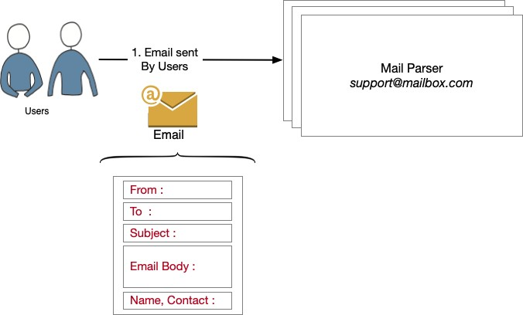
MAIL PARSER MAILBOX MODULE
Sent a sample email from the client to the MailParser id.
The original email in its current form from the users are stored to the MailParser email id.
User emails are then processed by MailParser inboxes.
Notes:
The first one is mail parser mailbox module
In this module, a sample email is sent from the customers directly to the mailparser id.
And then the original email is stored and processed by the mail parser.
-

Slide 10
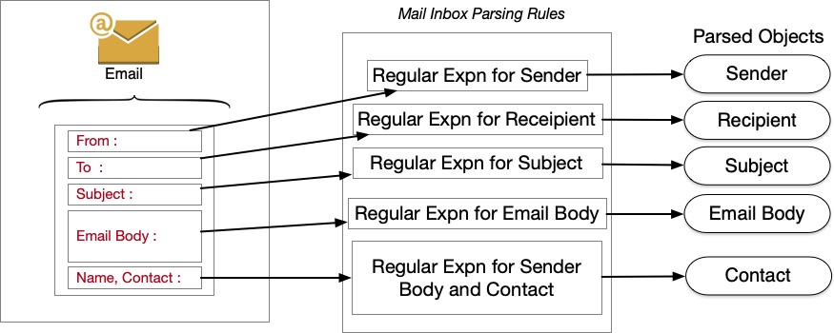
Rule parsing module
The original user mails are stored in the mail parser mailbox.
Parsing the user’s mail.
The parsed user email is processed into objects separately by using a set of parsing rules.
Notes:
The second module is rule parsing module,
The email in its current form from the previous module is stored in the mail parser mailbox and parsing the mail .
User emails are stored and processed by MailParser inboxes via a multi-step process which includes, saving the original email, parsing email data based on a set of user- defined parsing rules, creating necessary data objects, and invoking a pre-configured webhook dispatch.
The parsed mail is processed and separated into objects by using a set of user defined REGULAR EXPRESSION parsing rules.

Slide 11
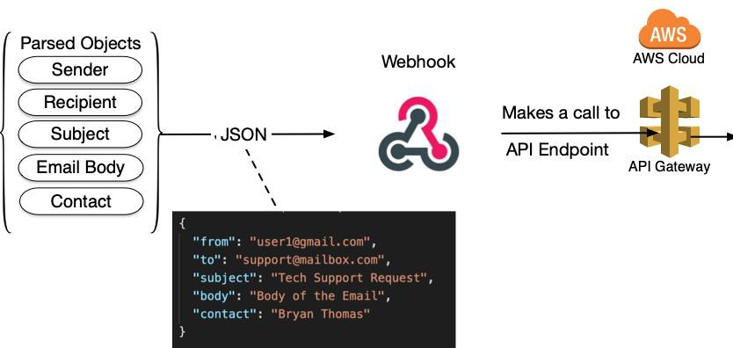
Parser Webhook API Module
The parsed objects are converted into JSON format.
The JSON format parsed objects are sent to the targeted URL by invoking a pre-configured webhook integrations.
The targeted URL reaches to the AWS Lambda via API gateway.
Notes:
The third module is parser webhook API module,
AS YOU CAN SEEE IN THE DIAGRAM
In this module,the parsed objects from the previous module are converted to JSON format.
The JSON formatted parsed objects are sent to the targeted URL by invoking a pre-configured webhook integrations.
The targeted URL reaches the AWS Lambda through API Gateway

Slide 12
API Gateway and Lambda Function Module
The targeted URL reaches the AWS Lambda via API gateway.
Parsed email is then sent to AWS Lambda through API Gateway by making an HTTP GET method request, and in response the API Gateway provides an HTTP Response with the status code and the response body.
When invoking the Lambda function, API gateway passes the formatted request object in JSON format. AWS Lambda processes the request which contains email data and executes various steps to generate email insights for sales and marketing.

Slide 13
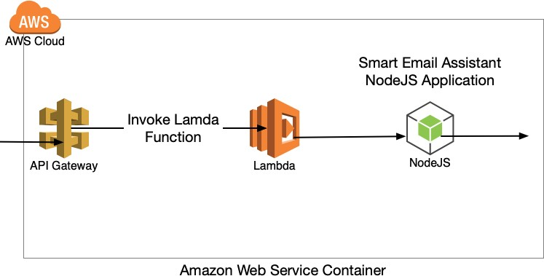
api gateway and lambda function module
Notes:
The fourth module is API Gateway and Labda functions module,
- As you can see in the diagram, the targeted URL NOW reached the AWS Lambda via API Gateway.
Parsed email is then sent to AWS Lambda through API Gateway by making an HTTP GET method request, and in response, the API Gateway provides an HTTP Response with the status code and the response body.
- API gateway passes the formatted request object in JSON format when invoking the lambda function. And then the AWS Lambda processes the request which contains email data and executes various steps to generate email insights.

Slide 14
Lambda Function and DynamoDB Module
API Gateway forwards the request to lambda function for request processing.
Lambda function receives the request, invokes smart email assistant application.
Smart Email Assistant processes the request and its associated content (JSON).
SEA populates necessary database tables after executing the algorithm.
SEA then creates a response body and sends it API Gateway with response body and a response code.

Slide 15
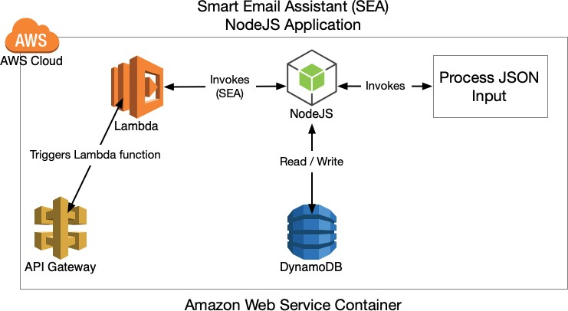
Lambda Function and DynamoDB Module
Notes:
And then comes the fifth module, the fifth module is API Gatewy and Lambdafunction module
API Gateway forwards the request to lambda function for request processing.
Lambda function receives the request, invokes smart email assistant application.
Smart Email Assistant processes the request and its associated content (JSON).
SEA populates necessary database tables after executing the algorithm.
SEA then creates a response and sends it back to API Gateway with response body and a response code to the mail parser .

Slide 16
Smart Email Assistant - Data Analysis Module
Lambda function (SEA Core Logic) receives the HTTP request from mail parser and executes a set of checks.
Performs a data cleaning operation for the incoming email.
Performs a data preparation for email body parsing
Stores email data to EMAIL table
Performs a keyword count for the pre-defined keywords stored in the KEYWORD table and updates the COUNT table.

Slide 17
Smart Email Assistant - Data Analysis Module
Updates the keyword sentence table with keywords and its context sentences.
Makes a yonder api call with the email body, and updates the following tables
Email_emotion (Emotional Reaction)
Emai_keywords (Keyword Extraction)
Email_entities (Entity Extraction) Email_sentiment (Sentiment Analysis)
Email_taxonomy (Taxonomy Classification)
Email_summary (Text Summarization)Email_tags (Concept Tagging)

Slide 18
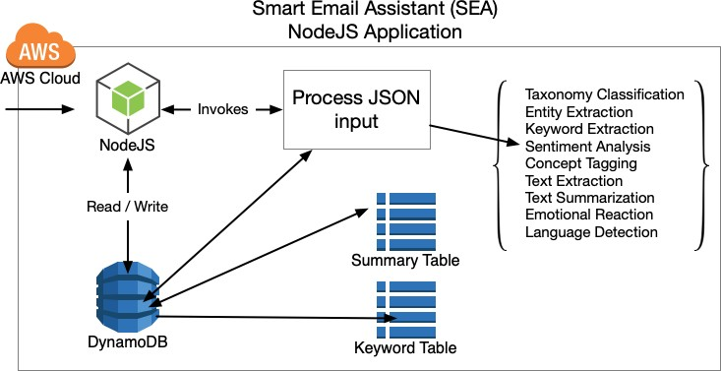
After successfully processing the HTTP Request from API Gateway, a response is created with a status code and response body.
If the algorithms fail or if any of the essential parameters are not passed along with the HTTP request, an error code and a message is retuned to the API gateway as a response.
Notes:
And then comes sixth module, the sixth module is data analysis module,
This one is the core module of the project.
Lambda function receives the HTTP request from mail parser and executes a set of checks.
Performs a data cleaning operation for the incoming email.
Performs a data preparation for email body parsing
Stores email data to EMAIL table
Performs a keyword count for the pre-defined keywords stored in the KEYWORD table and updates the COUNT table.
Updates the keyword sentence table with keywords and its context sentences.
Makes a yonder api call with the email body, and updates the following tables
Email_emotion (Emotional Reaction)
Emai_keywords (Keyword Extraction)
Email_entities (Entity Extraction)
Email_sentiment (Sentiment Analysis)
Email_taxonomy (Taxonomy Classification)
Email_summary (Text Summarization)
Email_tags (Concept Tagging)
After processing the HTTP Request from API Gateway, as a response API will send back with a status code and response body.
If the algorithms fail, an error status scode and a message is retuned to the API gateway as a response.

Slide 19
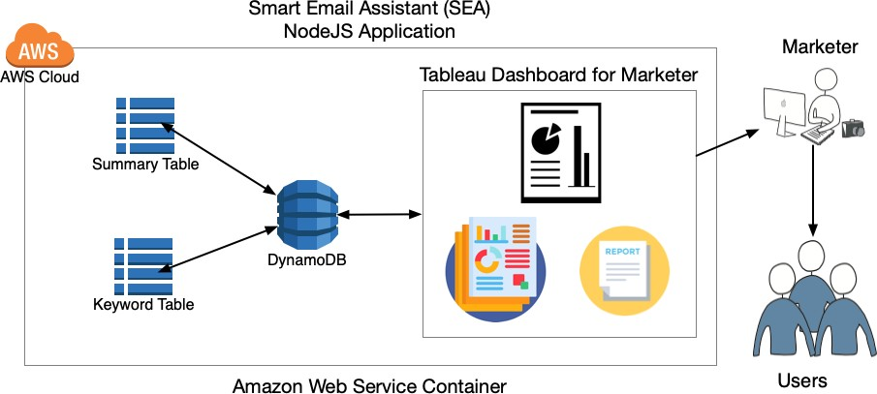
Tableau - Data Insight Module
Tableau dashboard reads data from the database and creates a graph report for marketers.
Insights obtained from the tableau report is then used by a marketer to prioritize the tasks, and then responds to a customer’s inquiry.
Notes:
And then comes the final module , the data insights module where the outputs are represented in a graphical presentation
After updating and processing all the tables in the dynamodb module
It sends all the results of each table to the tableau dashboard
Tableau dashboard reads data from the database and creates a graph report for marketers.
Insights obtained from the tableau report is then used by a marketer to prioritize the tasks, and then responds to a customer’s inquiry.

Slide 20
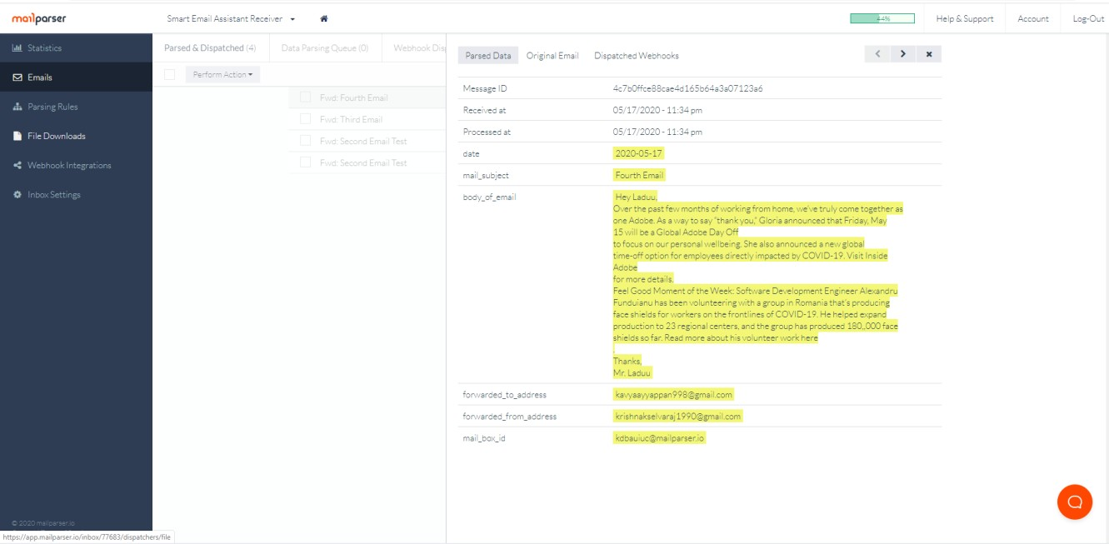
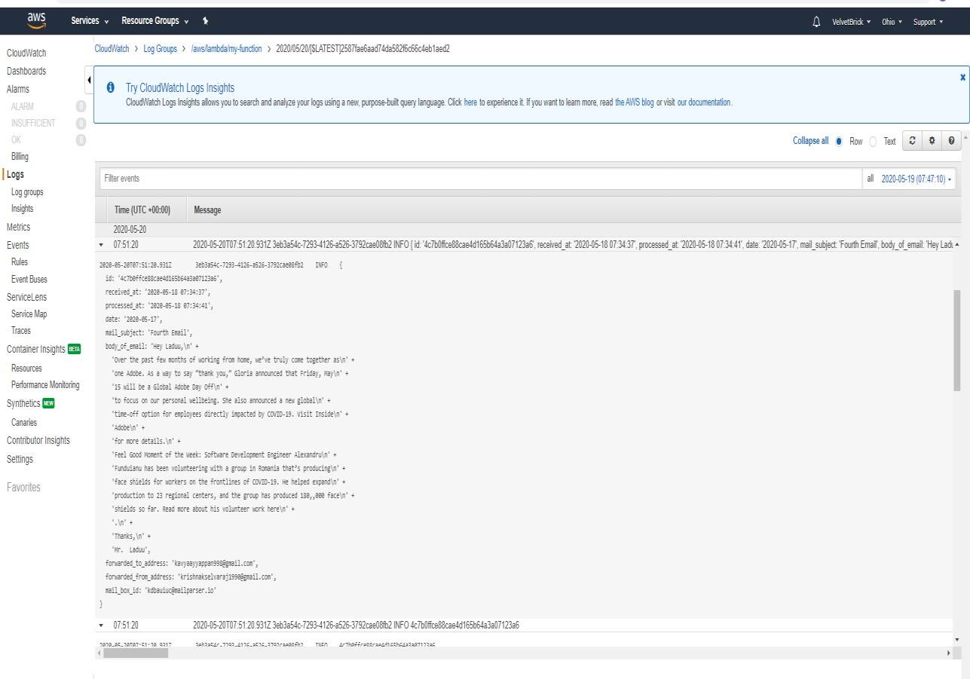
SNAPSHOTS OF RESULTS
MAILPARSSER
AWS CLOUDWATCH LOG
Notes:
THESE ARE THE SNAPSHOTS OF MAIL PARSER AND AWS CLOUDWATCH LOG
IN MAIL PARSER, WE CAN SEE OUTPUTS OF THE ORIGINAL MAIL WHICH IS STORED ON THE MAIL PARSER, THE PARSED DATA GENERATED USNG A SET OF REGULAR EXPRESSION PARSING RULES,AND THE PRE CONFIGURED WEBHOOK DISPATCH WHICH WLLL CONNECTED THE TARGETED URL TO THE MAIL PARSER
IN AWS CLOUD WATCH LOG

Slide 21
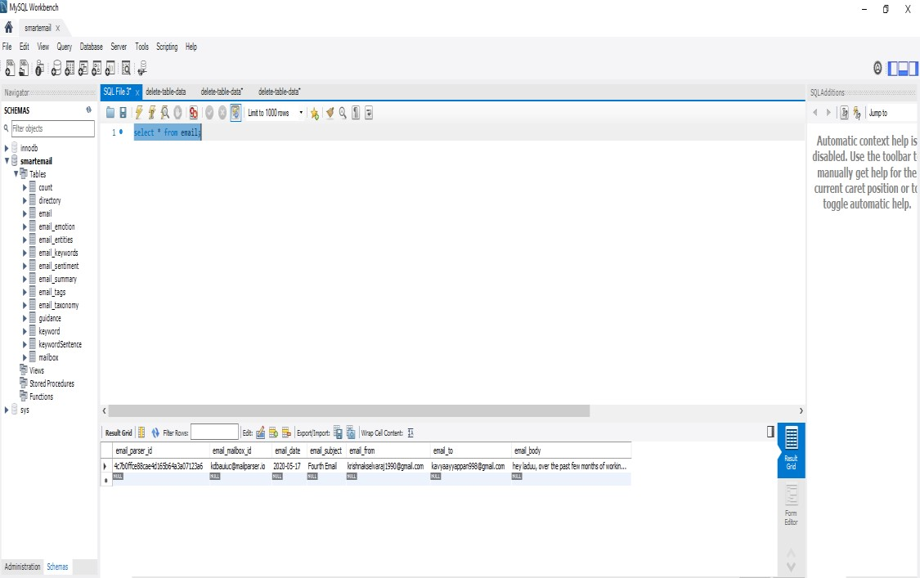
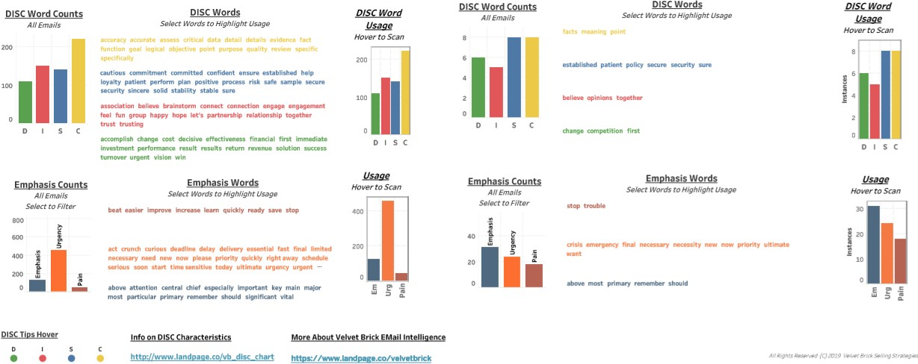
MYSQL WORKBENCH
TABLEAU

Slide 22
conclusion
Thus the problems faced by the sales and marketing team due to improper communication can be solved by smart email assistant.
Smart Email Assistant provides a multi-step solution to give a better customer experience for a customer's email communications.
And also facilitates better customer inquiries by closely montiring, tracking and prioritizing the mails from the customer.

Slide 23
REFERENCES
http://yonderlabs.github.io/api-docs/#intro-to-yonderapi
file:///C:/Program%20Files/WindowsApps/5319275A.WhatsAppDesktop_2.2019. 8.0_x64 cv1g1gvanyjgm/app/resources/app.asar/index.html#
https://patents.google.com/patent/US7103599B2/en
https://patents.google.com/patent/US8527436B2/en
https://patents.google.com/patent/US7174366B2/en
https://patents.google.com/patent/US7092993B2/en
https://docs.aws.amazon.com/AmazonRDS/latest/UserGuide/USER_CreateDBInst ance.html
https://docs.aws.amazon.com/lambda/latest/dg/lambda-nodejs.html

